Slide 1
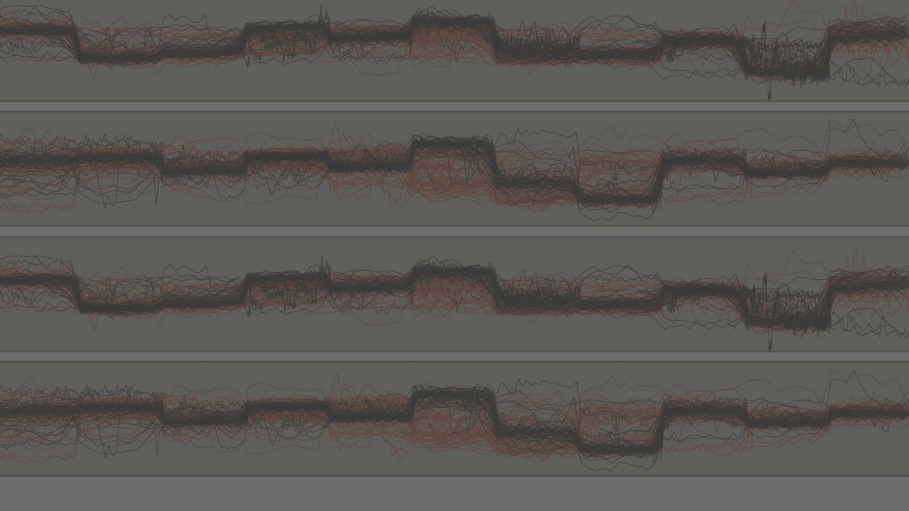
De novo Identification of DNA Modifications Enabled by Genome-Guided Nanopore Signal Processing
Oxford Nanopore Technologies Knowledge Exchange
Wednesday, July 5th, 2017
Marcus Stoiber, PhD, LBNL Postdoc (soon-to-be Oxford Nanopore Technologies)

Slide 2
nanoraw
Outline
What is (and isn’t) nanoraw?
How does it work?
Example nanoraw pipelines
Practical/computational considerations
Future directions and a wafer-thin intro to basecRAWller

Slide 3
nanoraw
nanoraw is an open source python package (w/command line interface) for the resolution of raw nanopore signal with a genomic alignment
This primarily enables:
Genome-browser style visualizations of raw nanopore data
De novo testing for shifts in signal (indicative of modified bases)
Enhanced training datasets
nanoraw does NOT improve sequence output of nanopore reads
nanoraw events perfectly match a genomic segment

Slide 4
nanoraw Relevant links
nanoraw available through the python package index (and bioconda; thanks internet!):
https://pypi.python.org/pypi/nanoraw/0.4.2
Code is hosted on github (this presentation is included in docs/):
https://github.com/marcus1487/nanoraw
And full documentation is hosted on readthedocs:
http://nanoraw.readthedocs.io/
Pre-print is available on bioRxiv (hopefully in print soon;):
http://biorxiv.org/content/early/2017/04/10/094672

Slide 5
nanoraw genome_resquiggle
Nanopore pairwise genomic alignment overlaid with raw signal
* Visualization available from plot_correction subcommand

Slide 6
nanoraw genome_resquiggle
Raw nanopore signal (x-axis: time; y-axis: normalized current)

Slide 7
nanoraw genome_resquiggle
Error-prone base calls

Slide 8
nanoraw genome_resquiggle
Genomic bases from obtained from alignment (graphmap or BWA)

Slide 9
nanoraw genome_resquiggle
Mismatch (a.k.a. Correct segmentation, but wrong base call)

Slide 10
nanoraw genome_resquiggle
Genomic insertion (a.k.a. Incorrectly added segment in read)

Slide 11
nanoraw genome_resquiggle
Genomic deletion (a.k.a. Extra segment needed in read)

Slide 12
nanoraw genome_resquiggle
Resolve mismatch (Trivial: assign genomic base to that segment)

Slide 13
nanoraw genome_resquiggle
Resolve insertion step 1: Remove segments surrounding insertion

Slide 14
nanoraw genome_resquiggle
Resolve insertion step 2: Identify new segment(s) (details later)

Slide 15
nanoraw genome_resquiggle
Resolve deletion step 1: Identify region surrounding deleted base

Slide 16
nanoraw genome_resquiggle
Resolve deletion step 2: Identify new segments (details later)

Slide 17
nanoraw genome_resquiggle
Identify new segments: Calculate running difference between neighboring windows of 4 observations

Slide 18
nanoraw genome_resquiggle
Select N maximal running differences as new segments

Slide 19
nanoraw plot_multi_correction
With genome resolved signal reads are anchor by genomic position
Next step is to contract each base’s signal to fixed intervals

Slide 20
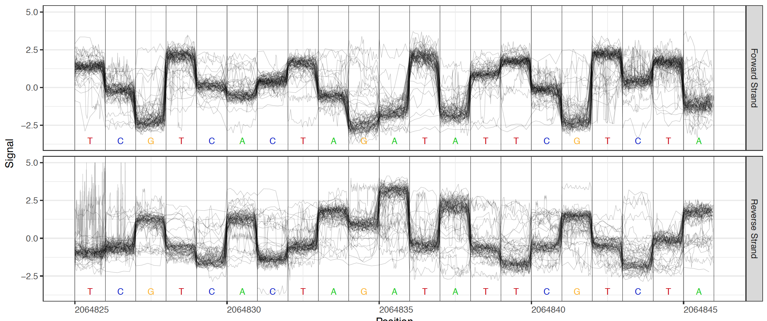
nanoraw plot_*
Now we have comparable raw signal across all reads from a run

Slide 21
nanoraw plot_*
Select genomic regions to plot via several criterion:
Maximum coverage (plot_max_coverage)
Genomic locations (plot_genome_location)
Centered on K-mer of interest (plot_motif_centered)
Require two sets of files:
Maximum difference in signal level (plot_max_difference)
Most significant difference in signal (plot_most_significant)

Slide 22
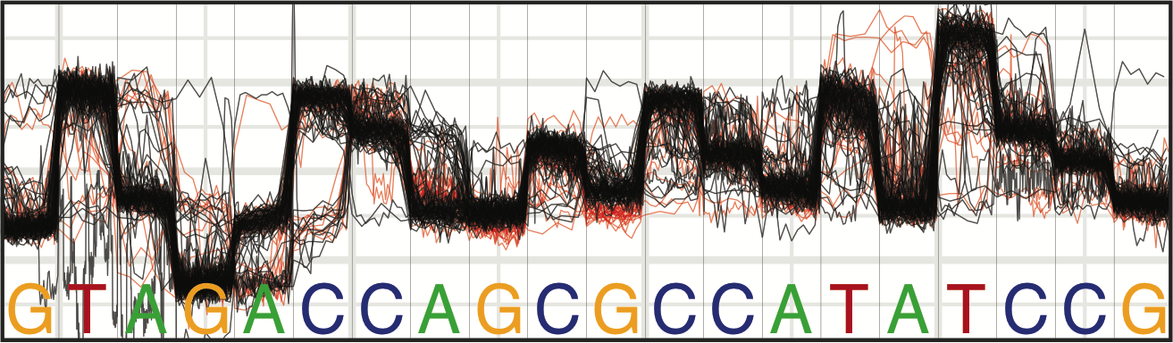
nanoraw Statistical Testing
Red: Amplified Black: Native
Detect modified DNA nucleotides genome-wide by comparison of amplified and native samples (Mann-Whitney U-Test)

Slide 23
nanoraw Statistical Testing
Testing-based Identification | Model-based Identification
No training data needed Identification of modified and un-modified bases in close proximity Any modification detectable | Exact chemical modification known Exact modification position known Only native DNA needed after training

Slide 24
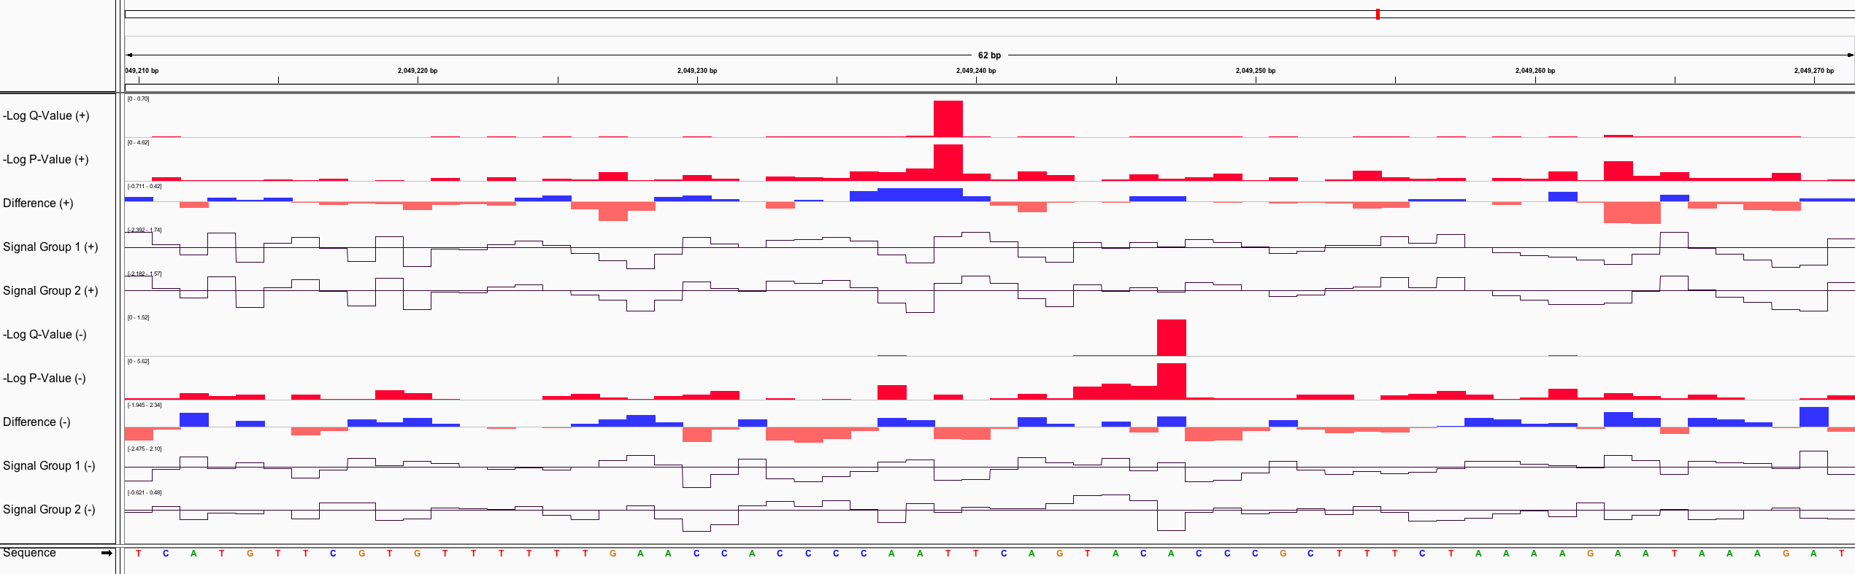
nanoraw write_wiggles
Output wiggle files for: Coverage, Signal, Signal SD, Length, P-values, Q-values, Difference

Slide 25
nanoraw Example Pipelines
All nanoraw analysis requires running genome_resquiggle
(more on this later)
Example pipelines:
Modified base detection
Visualize single run
Visualize comparison of two runs

Slide 26
nanoraw Example Pipelines
Modified base detection:
Run write_wiggles with 2 groups of fast5 directories and
specify –wiggle-types difference qval
Considerations:
Test statistic (u-test vs t-test; Fisher’s Method; Min. coverage)
Statistics filename
Stalled read filtering (more next slide)
* Does not require installing R, rpy2 and ggplot2 (default pip install)
Notes:
Also create fasta with most significant signal shifted regions without plotting support.

Slide 27
nanoraw Example Pipelines
Single Run Visualization:
Run plot_* with a single (set of) fast5 directory(ies)
Considerations:
Region Selection: Maximum coverage, genome location, motif centered
Over-plotting options: Raw (down-sampled), Boxplot, Quantile, Violin*
Number of bases and regions
Observations per base filter: Don’t include “stuck reads” when plotting. These can cause over-plotted from few reads.
Notes:
Based on percentiles of observations per base. Reads with 99th pctl <200 obs and max <5k obs would be "99:200 100:5000"

Slide 28
nanoraw Example Pipelines
Two Run Visualization:
Run plot_* with a two (sets of) fast5 directories
Considerations:
Region Selection: Most significant, largest difference
Q-value threshold (probably best to check this first)
Sequences file (fasta for the plotted regions)

Slide 29
nanoraw Practical Considerations
Re-squiggle Processing Architecture
Aligned Read
FAST5 Batch
Threaded Alignment Processes
Aligned Read
FAST5 Batch
Basecalled FAST5 Files
FAST5 Batch
Aligned Read
FAST5 Batch
Aligned Read
…
…
Genome FASTA
Re-squiggle Processes
Modified
FAST5 Files
…
Notes:
Requires basecalling with events storage (note that minknow does not store events) albacore recommended for now

Slide 30
nanoraw Practical Considerations
Re-squiggle Processing Architecture
Choosing alignment parameters:
--align-batch-size: Each batch triggers a new system call to the mapper
--align-processes: Each processes must load the genome for each batch
--align-threads-per-process: Passed on to the mapper system call
Mapper: must provide either graphmap or bwa executable (argument should be runnable as provided)
FAST5 Batch
Threaded Alignment Processes
FAST5 Batch
Basecalled FAST5 Files
FAST5 Batch
FAST5 Batch
…
…
Genome FASTA
Default behavior: 1 alignment process with 500 read batches; 1 re-squiggle process
Notes:
Batch size to threads is very important. Bwa groups reads and threads finish independently, so large batches into many threads, but few processes can take a long time.

Slide 31
nanoraw Practical Considerations
Re-squiggle Processing Architecture
Aligned Read
Re-squiggle Parameters:
--resquiggle-processes: Each process pulls one read off the queue at a time (relatively fast; esp. for long reads)
--cpts-limit (and –timeout): Filter reads that require nanoraw to re-segment large single portions of a read
--normalization-type: normalization parameters are stored back into FAST5 (median or pA recommended).
--corrected-group: This is the group added to the FAST5 file. Default value links to other nanoraw commands
--overwrite: delete old corrected group
Aligned Read
Aligned Read
Aligned Read
Re-squiggle Processes
Modified
FAST5 Files
…
Notes:
Don’t use raw_pA

Slide 32
nanoraw Practical Considerations
nanoraw FAST5 format:
/Analyses/RawGenomeCorrected_000/
nanoraw version and linked basecalling slot
BaseCalled_template
Normalization parameters (shift, scale, outlier threshold, norm type)
Alignment
Mapping position and alignment statistics (clipping, indels and (mis)matches)
genome_alignment and read_alignment: when zipped together gives the pairwise alignment for a read
read_segments: Read base start positions within raw signal file
Events
Read_start_rel_to_raw: needed when using read_segments to access raw signal
Stripped down version of ONT events format (mean, stdev, start, length, base)
Notes:
Genome sequence included in files.

Slide 33
nanoraw Practical Considerations
Other considerations:
2D and 1D²: Don’t use 2D complement for modified base testing. 1D² complement should be good (not tested)
--recursive convenience option added for new sub-directory structure
--fast5-pattern for more complex FAST5 stored reads (quote *)
--statistics-filename: Written first time statistics are computed and then loaded every time after that. Huge speed up for region selection, wig, etc.
Make sure processes are killed after aborting a run before starting another
Other plotting functions: motif_with_stats, cluster_most_significant, correction plots, kmer signal distribution

Slide 34
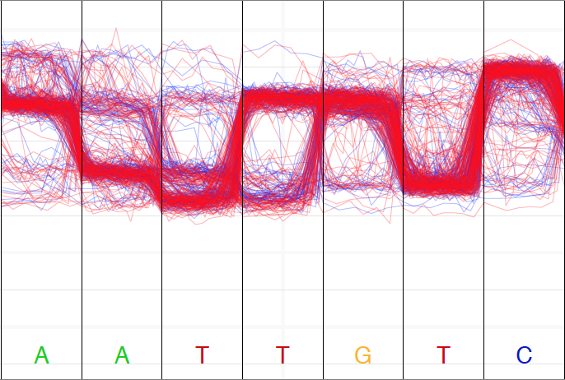
nanoraw Future Directions
nanoraw 2.0: Iterative segmentation refinement
Define signal reference from all reads
Identify stretches of reads with signal that aligns better off-by-one (OBO) base
Extend stretches to maximal OBO region
Add and remove a segment before and after OBO region to correctly adjust the OBO region
Iterate

Slide 35
basecRAWller Streaming Basecalling Directly from Raw Signal

Slide 36
basecRAWller Streaming Basecalling Directly from Raw Signal
basecRAWller is a python based command line application for the training and running neural network based basecalling algorithm
No fee source code license for non-commercial use at basecRAWller.lbl.gov
To call bases with default model:
> basecRAWller call --fast5-basedirs path/to/fast5s/ \
--out-filename basecRAWller_reads.fasta
Call bases from another model (from community or trained):
> basecRAWller call --fast5-basedirs path/to/fast5s/ \
--out-filename basecRAWller_reads.fasta \
--raw-checkpoint-directory raw_checkpoints_dir/ \
--ft-checkpoint-directory fine_tune_checkpoints_dir

Slide 37
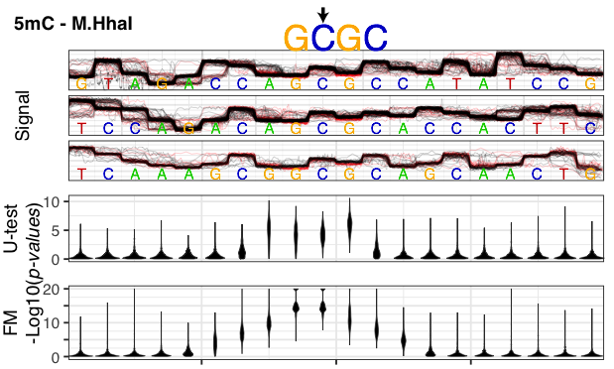



Thanks!
nanoraw
basecRAWller
University of Birmingham
Nick Loman
Josh Quick
Robert Neely
NERSC
Prabhat
LBNL
Ben Brown
Len Pennacchio
Rob Egan
Juna Lee
Susan Celniker
LBNL
Ben Brown

